Slide 1
CHAPTER 6
INDEXES, SCALES,
AND TYPOLOGIES

Slide 2
Survey Scales
Commonly used in psychological research:
  Personality (Big 5)
  Mindfulness (FFMQ)
  Self-Efficacy (GSE)
Practically any construct can be measured using the right set of questions!

Slide 3
Survey Scales
Example:
  “I like to have a lot of people around me.”
How should participants respond?

Slide 4
Survey Scales
Survey Scale == orderly arrangement of survey response options
  Binary: Yes – No, Agree-Disagree
  Multiple: 0 – 100 (extreme)
    1 – 5 is common (Likert Scale)

Slide 5
Scale Construction
Likert Scaling – Uses standardized response categories to determine the relative intensity of different items.

Slide 6
Likert Scales
Good: Rate from 1 – 5, 1 – 7, etc.
Maybe bad? Rate from 1 – 4, 1 – 6, etc.

Slide 7
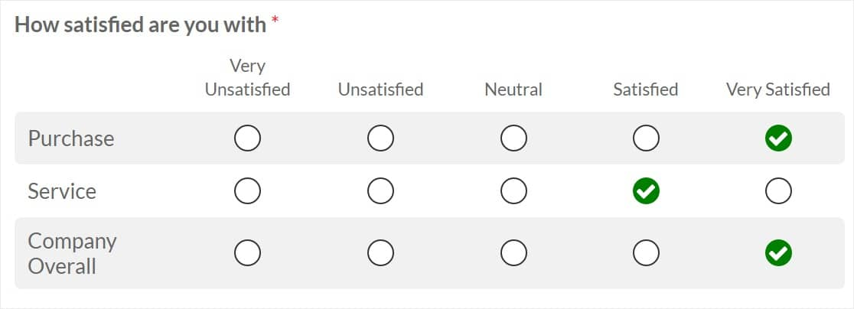
Likert Scales

Slide 8
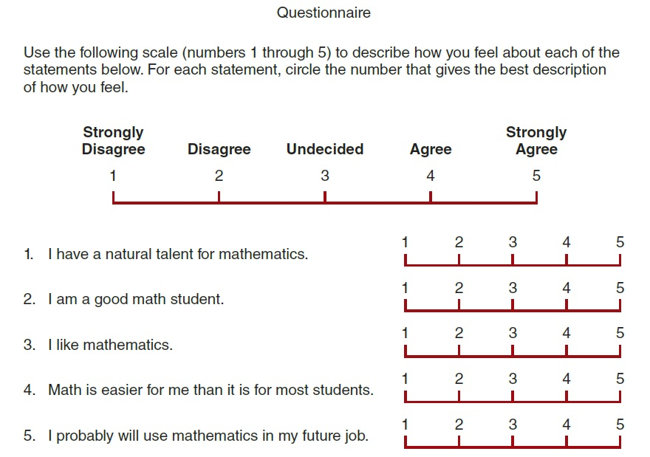
A Likert-Type Rating Scale
Notes:
Figure 13.1 A Likert-Type Rating Scale and a Series of Questions Examining Elementary School Students’ Attitudes about Mathematics
The participants’ responses consist of numerical ratings for each of the five questions. The numbers can be added and averaged and are compatible with most standard statistical procedures.

Slide 9
Scale Construction
Other scale types:
  Semantic Differential – A questionnaire format in which the respondent is asked to rate something in terms of two, opposite adjectives.
    Example: Good vs. Bad; Hot vs. Cold, etc.

Slide 10
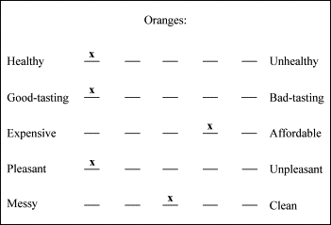
Scale Construction
Doesn’t have to be binary!

Slide 11
Composite Measures
Scales are best when data comes from multiple points
  Examples:
    Multiple questions on a survey assessing the same thing (good)
    Using multiple surveys to measure one construct (even better)
    More questions assessing the same thing, the better!

Slide 12
Composite Measures
Create a composite score by combining responses from multiple questions
Example:
  I worry about things often. 5
  I often feel inferior to others. 4
  I can’t handle being under lots of stress. 4
What are we measuring?

Slide 13
Composite Measures
Create a composite score by combining responses from multiple questions
Example:
  I worry about things often. 5
  I often feel inferior to others. 4
  I can’t handle being under lots of stress. 4
  13

Slide 14
Composite Measures
Create a composite score by combining responses from multiple questions
Example:
  I worry about things often. 5
  I often feel inferior to others. 4
  I can’t handle being under lots of stress. 4
  13 / 3 =

Slide 15
Composite Measures
Create a composite score by combining responses from multiple questions
Example:
  I worry about things often. 5
  I often feel inferior to others. 4
  I can’t handle being under lots of stress. 4
  13 / 3 = 4.33

Slide 16
Getting composite from Scale
Summation!
  A score of 15 == extremely high; score of 3 == extremely low
Average!
  A score of 5 == extremely high; score of 1 == extremely low

Slide 17
Weighted Scales
Some scale items may more strongly reflect a concept than others
Example: Political activism
  Running for political office reflects more activism than just voting
Scale questions can be weighted to reflect this!

Slide 18
Example: Measuring Extraversion
“I like to have a lot of people around me.”
What else??

Slide 19
Composite Measures
“I like to have a lot of people around me.”
“I laugh easily.”
“I keep to myself”

Slide 20
Composite Measures
Why do quantitative researchers use composite measures?
  Use ordinal measures (participants can rank order these)
  Efficient for data analysis
  No clear, unambiguous single indicators

Slide 21
Creating Composite Scores
Where does the data come from though?
Scales and Indexes (indices)!

Slide 22
Indexes
Summarize responses for multiple, rank-ordered questions/statements
Often binary in nature (“yes-no” responses)
Don’t account for degree of response strength (e.g., Likert scales)
  No middle ground!

Slide 23
Index Example: Job Related Depression
For each question, respond “yes” or “no”:
  "When I think about myself and my job, I feel downhearted and blue.“
  "When I’m at work, I often get tired for no reason.“
  "When I’m at work, I often find myself restless and can’t keep still.“
  "When at work, I am more irritable than usual."

Slide 24
Creating Composite from Index
Summation!
  Add up all the “yes” questions (or the “no” questions, depends on the research design!)
What is the cut off for job related depression?
  Example: A score above “3” indicates depression

Slide 25
Scales vs. Indexes?
Similar to indexes, but….
Scales have a logical order/empirical structure
  Differences in response intensity!
Example: Likert Scales
  1 – 5 ratings (1 = strongly disagree; 5 = strongly agree)

Slide 26
Indexes vs. Scales Recapped
Index – A type of composite measure that summarizes and rank-orders several specific observations and represents some more general dimensions.
Scale – A type of composite measure composed of several items that have a logical or empirical structure among them.

Slide 27
Similarities
Both scales and indexes are ordinal measures of variables.
Both scales and indexes are composite measures of variables – measurements based on more than one data item.
  This is because both have multiple questions!

Slide 28
Differences
Indexes only consider scores assigned to individual items.
  No averaging across items, no weighted responses (usually….)
Scales are more interested in patterns of responding
  Can average across items assessing the same construct
  Can weight question responses

Slide 29
Indexes versus Scales
Scales are generally superior to indexes:
  Take into consideration the intensity that different items reflect the variable being measured.
  Scales have many items measuring same thing (different wording, assessing different elements of variable, etc.)
  Indexes can have many items, but are usually shorter

Slide 30
Index Construction
Steps:
  Item Selection
  Examination of Empirical Relationships
  Index Scoring
  Handling Missing Data
  Index Validation

Slide 31
Scale/Index Construction
Item Selection:
  Face Validity (Do items look like they measure the right thing?)
  Unidimensionality (Do items only measure one thing?)
  General or Specific (Too vague?)
  Variance (How are participants responding?)

Slide 32
Scale/Index Construction
Scoring
  Determine the desirable range of the index scores
    Index: What is your cutoff point???
    Balance! Make sure you have enough questions/statements…. but not too many!

Slide 33
Scale/Index Construction
Scoring
  Determine whether to give each item in the index equal or different weights.
    Standard: items should be weighted equally unless there are compelling reasons for differential weighting.

Slide 34
Typologies
Typology – The classification of observations in terms of their attributes on two or more variables.
Scale/Index Scores often correlate
  Example: Individuals high in Extraversion, usually high in Agreeableness but low in Neuroticism.
Used as a descriptor/predictor

